Slide 1
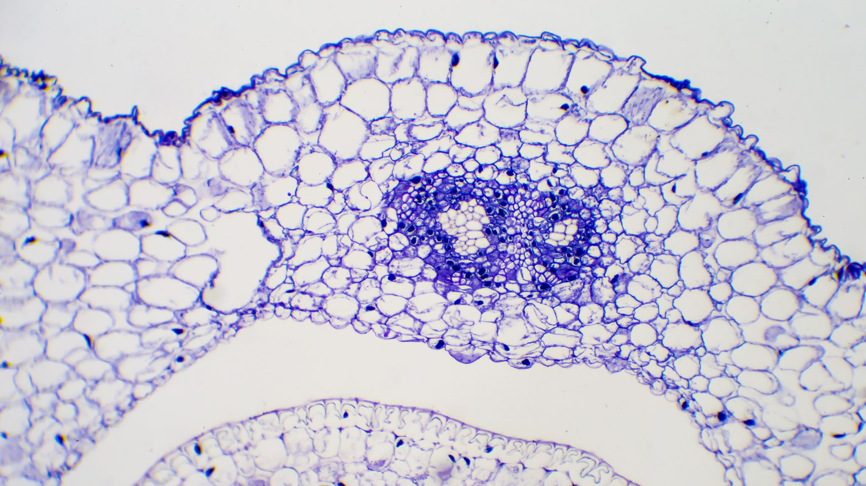
CNN Classificaçao tumor cerebral

Slide 2
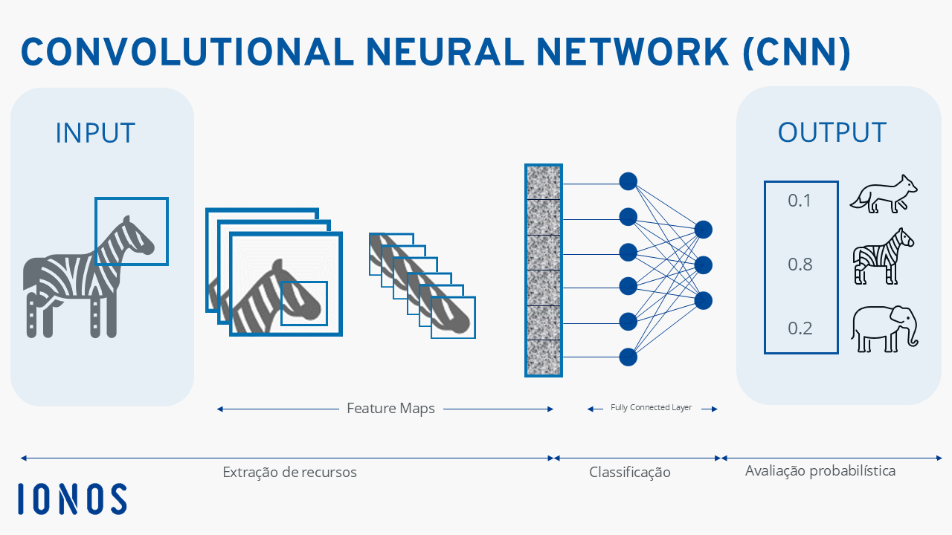
Treino e classificaçao
Samples de treino: 4571
Validation Samples: 1141 Modelo: Sequencial Iteraçoes :
15

Slide 3
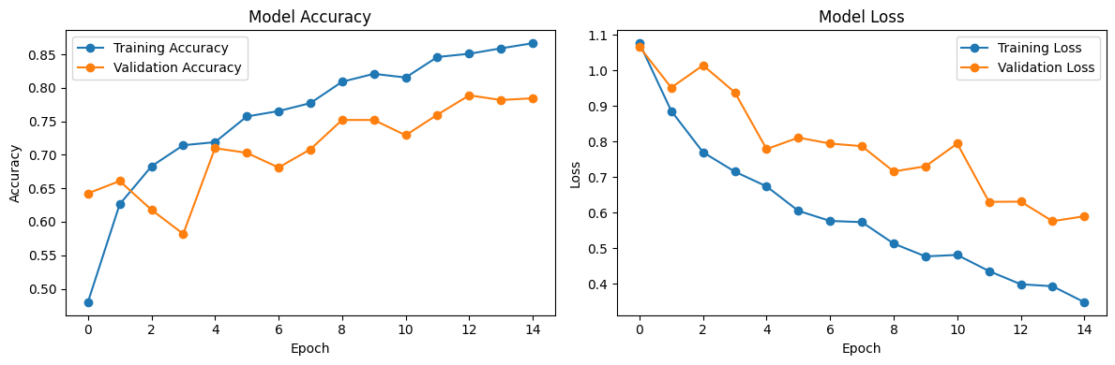
Iteraçoes
DataSet Utilizado: https://www.kaggle.com/datasets/masoudnickparvar/brain-tumor-mri-dataset

Slide 4
Accuracy
 | Precision | Recall | F1-score | support
Glioma | 0.89 | 0.76 | 0.82 | 300
Meningioma | 0.74 | 0.61 | 0.67 | 306
No Tumor | 0.80 | 0.99 | 0.88 | 405
pituitary | 0.91 | 0.91 | 0.91 | 300
Accuracy |  |  | 0.83 | 1311
Macro Avg | 0.83 | 0.82 | 0.82 | 1311
Weighted avg | 0.83 | 0.83 | 0.82 | 1311
Global Accuracy: 82.99%

Slide 5
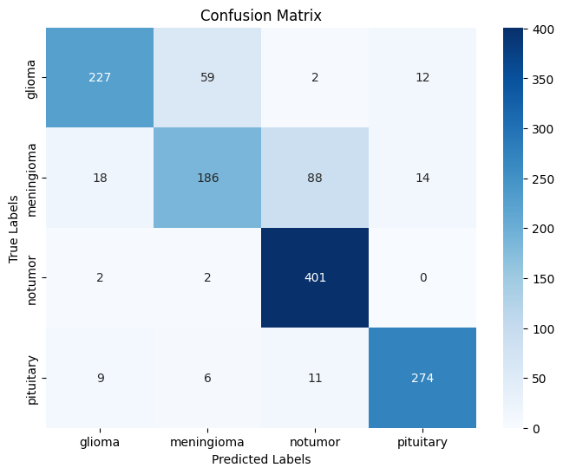
Confusion Matrix

Slide 6
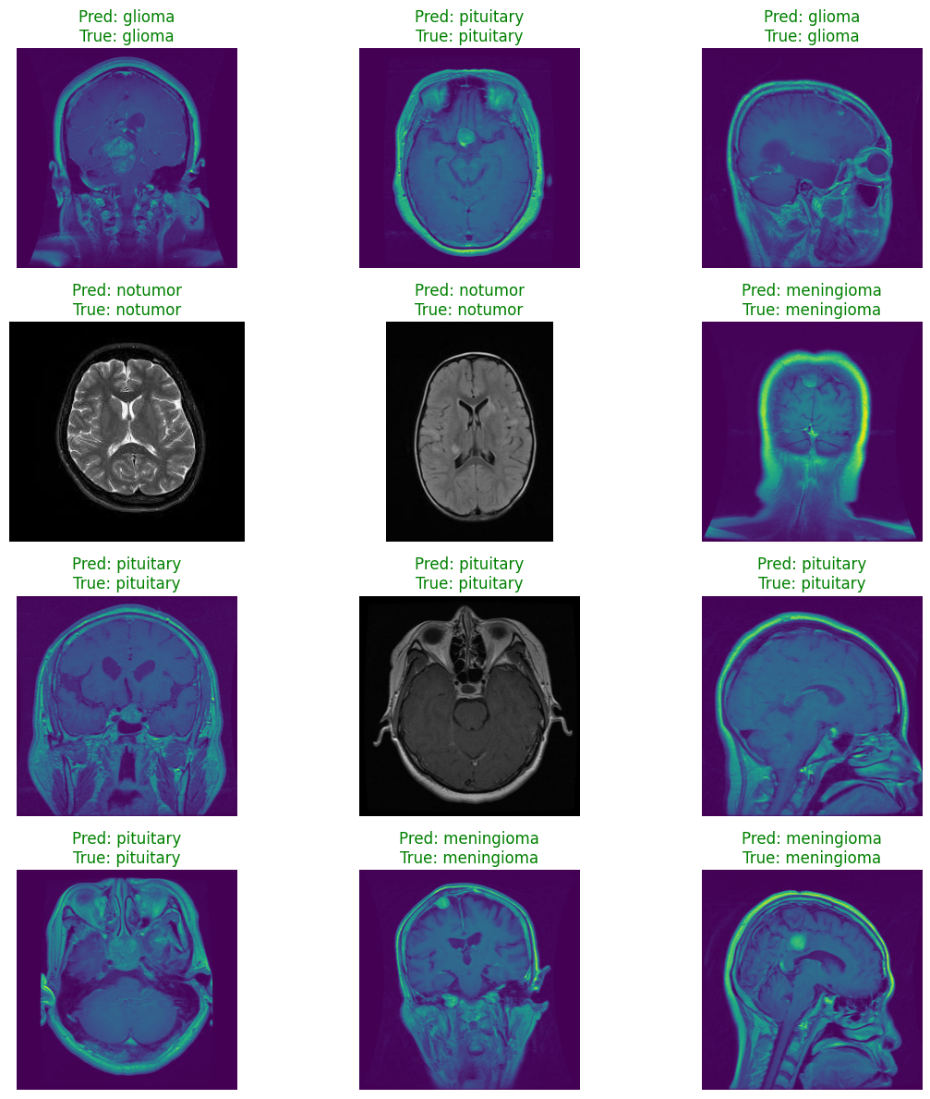
Examples

Slide 7
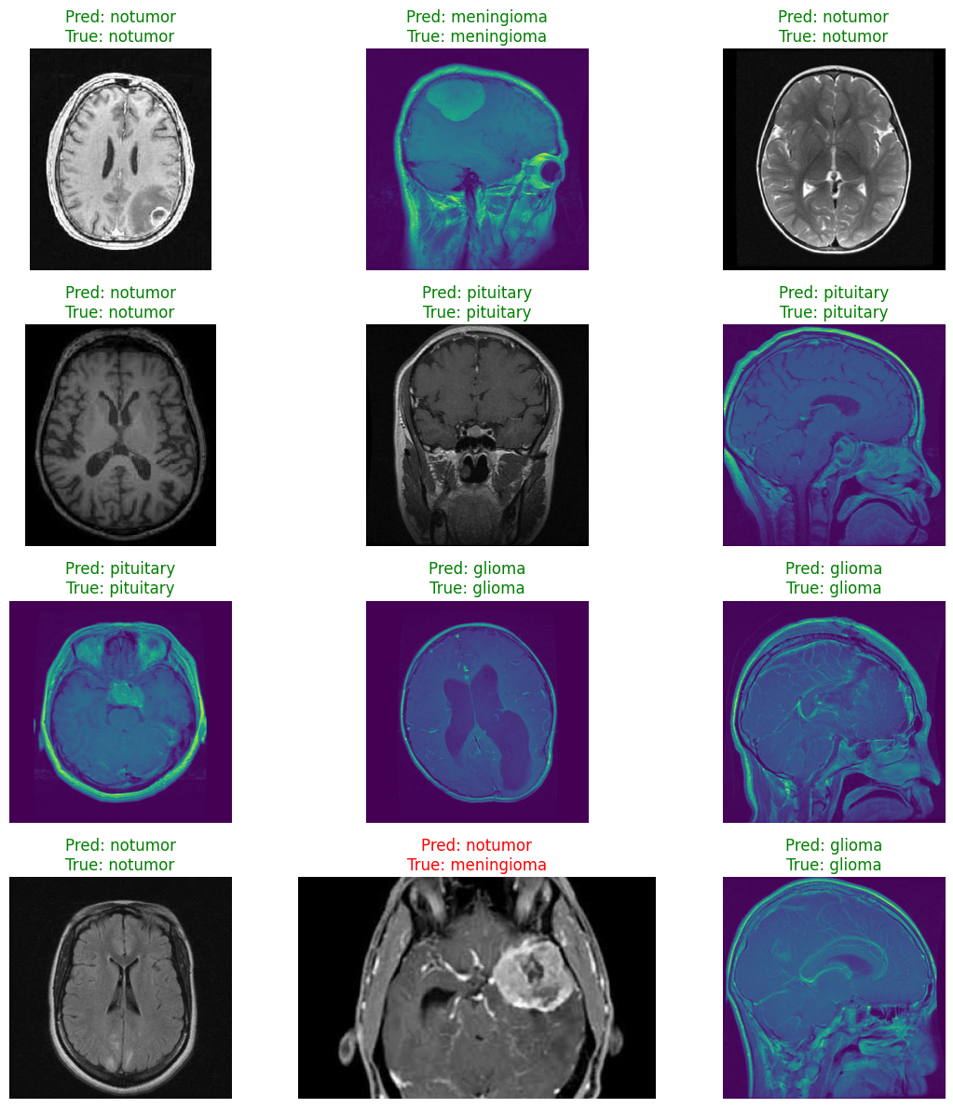
Examples 2

